Slide 1

Functions of Random Variables II
New and Improved Version!
Massachusetts Institute of Technology
Fall 2017
Richard C. Larson

Slide 2
Where we are…
Finish functions of random variables today
Then two lectures on Geometrical Probability (actually that starts today!)
Professor Arnold Barnett will give lecture next Monday.
Then Wednesday next week we start queues.

Slide 3
REVIEW: 4 Steps to Happiness:
1. Define the Random Variables
2. Identify the joint sample space
3. Determine the probability law over the sample space
4. Carefully work in the sample space to answer any question of interest

Slide 4
4 Steps: Functions of R.V.s
1. Define the Random Variables
2. Identify the joint sample space
3. Determine the probability law over the sample space
4. Carefully work in the sample space to answer any question of interest
4a. Derive the CDF of the R.V. of interest, working
in the original sample space whose probability
law you know
4b Take the derivative to obtain the desired PDF

Slide 5

Carefully work in the sample space to answer
any question of interest.
F_{Y}(y) = P{Y<y}=
P{MIN[X₁, X₂ ]<y}
=1-(1-y)²
f_{Y}(y)=d/dy [F_{Y}(y)]
f_{Y}(y)=2(1-y), 0<y<1
x₂
1
y
0
y
1
x₁
4a. Derive the CDF of the R.V. of interest, working
in the original sample space whose probability
law you know
4b Take the derivative to obtain the desired PDF

Slide 6
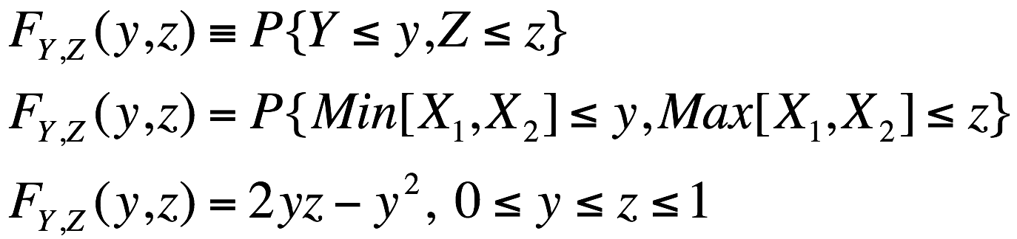
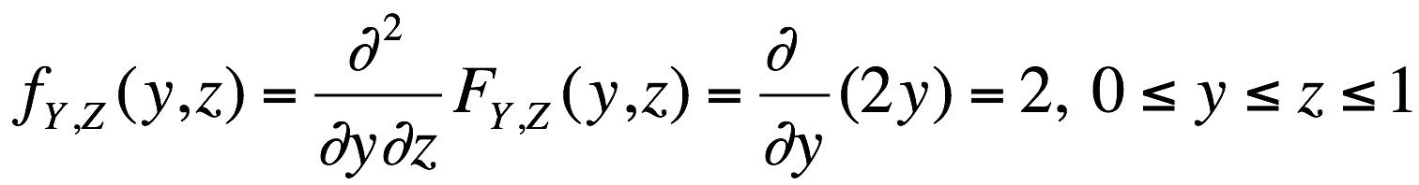
Work within the sample space
x₂
Use CDF
1
z
y
y
z
1
x₁

Slide 7
Work within the sample space
z
Height of pdf = 2
1
What do we do if we do
not have the simple square
symmetry of this problem?
What do we do if the pdf is
not uniform?
0
1
y

Slide 8

Buffon’s Needle Experiment (18th Century) https://en.wikipedia.org/wiki/Buffon%27s_needle

Slide 9
width of stripe =
d
l < d
length of needle =
l

Slide 10
1. The R.V.’s
Y = distance from the center of the needle to closest of equidistant parallel lines 0< y < d/2
Φ = angle of needle wrt horizontal 0< φ < π

Slide 11
φ
d/2
φ
y
(l /2)sin(φ)
Want {y <(l /2) sin(φ)}= Event that the needle lies on two colors

Slide 12
2. Joint Sample Space
y
d/2
0
φ = π
φ

Slide 13
3. Joint Probability Distribution
Want f_{Y,Φ} (y,φ)
Think about that tricky phrase, “At random”
f_{Φ} (φ) = 1/π 0 < φ < π
f_{Y} (y) = 2/d 0 < y < d/2
Independence implies
f_{Y,Φ} (y,φ) = f_{Φ} (φ) f_{Y} (y)= constant = 2/(π d)

Slide 14
4. Working in the Joint Sample Space
y
Want {y - (l /2) sin(φ)} < 0 or...
d/2
0
φ = π
φ

Slide 15
4. Working in the Joint Sample Space
y
y < (l /2) sin φ
d/2
(l /2) sin φ
0
φ = π
φ

Slide 16
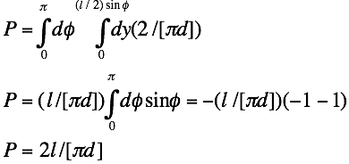
Suppose l = d……. What is March 14?

Slide 17
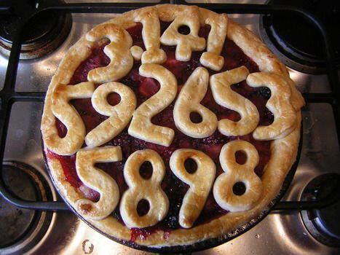

Slide 18
Spin the Flashlight

Slide 19
Point of flashlight
illumination
1
θ
x
x axis

Slide 20
Point of flashlight
illumination
1
θ
0
x
x axis
1. R.V.': X, Θ

Slide 21
Point of flashlight
illumination
1
θ
x
x axis
1. R.V.': X, Θ
2. Sample space for Θ: [-π/2, π/2]

Slide 22
Point of flashlight
illumination
1
θ
x
x axis
1. R.V.': X, Θ
2. Sample space for Θ: [-π/2, π/2]
3. Θ uniform over [-π/2, π/2]

Slide 23
Point of flashlight
illumination
1
θ
0
x
x axis
1. R.V.': X, Θ
2. Sample space for Θ: [-π/2, π/2]
3. Θ uniform over [-π/2, π/2]
4. (a) F_{X}(x) = P{X<x} = P{tanΘ<x}=P{Θ < tan⁻¹(x)}= 1/2 + (1/π) tan⁻¹(x)
(b) f_{X}(x) =(d/dx) F_{X}(x) = 1/[π(1 + x²)] all x
Cauchy pdf Do you see anything unusual about the Cauchy pdf?

Slide 24
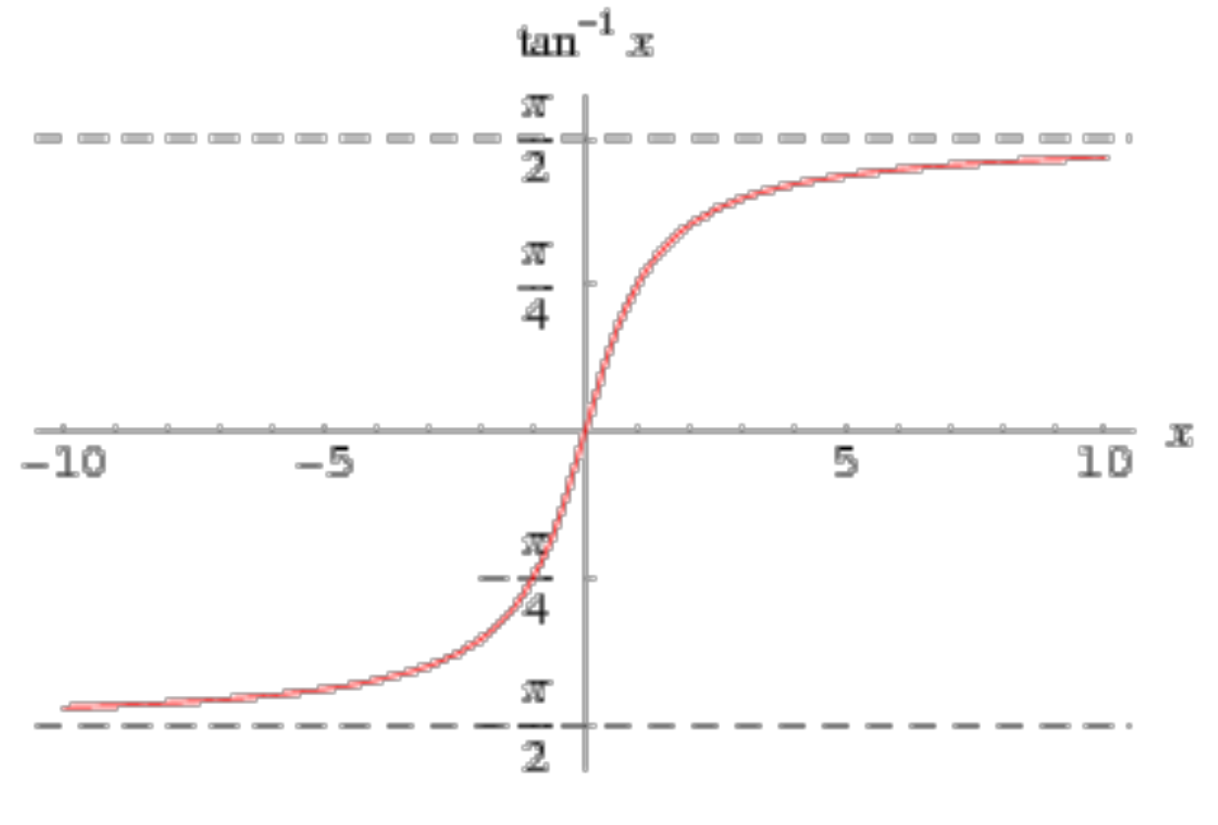
Perhaps Helpful for
Spin the Flashlight

Slide 25
Barriers to Travel
Perturbation Random Variables

Slide 26
Y₀
Directions of travel
0
X₀
E[D] = (1/3) [X₀ + Y₀ ]

Slide 27
Add a barrier to travel
Y₀
a
Directions of travel
0
b
X₀
E[D] = (1/3) [X₀ + Y₀ ]
D' = D + D_{e} , E[D' ]= E[D ] + E[D_{e} ]
E[D_{e} ] = E[D_{e} |D_{e} >0 ] P{D_{e} >0 }

Slide 28
Add a barrier to travel
Y₀
a
Directions of travel
E[D] = (1/3) [X₀ + Y₀ ]
D' = D + D_{e} ,
E[D' ]= E[D ] + E[D_{e} ]
E[D_{e} ] = E[D_{e} |D_{e} >0 ] P{D_{e} >0 }
0
b
X₀
P{D_{e} >0 } = 2 (ab)(a[X₀ - b])/{(X₀Y₀)(X₀Y₀)}

Slide 29
Add a barrier to travel
Y₀
a
Directions of travel
Z₂
Z₁
E[D] = (1/3) [X₀ + Y₀ ]
D' = D + D_{e} ,
E[D' ]= E[D ] + E[D_{e} ]
E[D_{e} ] = E[D_{e} |D_{e} >0 ] P{D_{e} >0 }
0
b
X₀
{D_{e} |D_{e} >0} = 2 MIN [Z₁,Z₂]
E[D_{e} |D_{e} >0] = (2/3)a
P{D_{e} >0 } = 2 (ab)(a[X₀ - b])/(X₀Y₀)(X₀Y₀)

Slide 30
Add 2 barriers to travel
Y₀
a
Directions of travel
Z₂
Z₁
0
b
X₀

Slide 31
And what about grids and one way streets?

Slide 32

Two-Way Streets
m = 7
n = 10
Then, what about alternating one-way streets?

Slide 33
A Quantization Problem

Slide 34
NYC Marine Transfer Station
Tug
Delivers
LIGHTS
Tug
Picks Up
HEAVIES
LIGHT and HEAVY
Barges Stored
Loading
Barge
Barges
Shifted
By Hand
Or Tug
Refuse
Inflow
λ_{i} (t)
Loading
Barge

Slide 35

Data Only Given in Integer Full Barges
Fresh Kills Landfill
TUG
DELIVERS
HEAVIES
Digger
HEAVY BARGES
UNLOADING
BARGE
REFUSE
UNLOADED
HEAVY BARGES
TUGS PICK
UP LIGHTS
UNLOADING
BARGE
LIGHT
BARGES
Digger

Slide 36
1. The R.V.’s
D = barge loads of garbage produced on a random day (continuous r.v.)
Θ = fraction of barge that is filled at beginning of day (0 < Θ < 1)
K = total number of completely filled barges produced by a facility on a random day (K integer)
K = [ D + Θ ] = integer part of D + Θ

Slide 37
2. The Sample Space
θ
1
0
d

Slide 38
θ
1
0
1
2
3
d

Slide 39
θ
1
K = 0
K = 1
K = 2
K = 3
0
1
2
3
d

Slide 40
3. Joint Probability Distribution
a) D and Θ are independent.
b) Θ is uniformly distributed over [0, 1]
f_{D,Θ}(d, θ) = f_{D}(d) f_{Θ}(θ) = f_{D}(d)(1) = f_{D}(d), d > 0, 0 <θ <1
θ
1
K = 0
K = 1
K = 2
K = 3
0
1
2
3
d

Slide 41
3. Joint Probability Distribution
a) D and Θ are independent.
b) Θ is uniformly distributed over [0, 1]
f_{D,Θ}(d, θ) = f_{D}(d) f_{Θ}(θ) = f_{D}(d)(1) = f_{D}(d), d > 0, 0 <θ <1
θ
1
x
K = 0
K = 1
K = 2
K = 3
1-x
0
1
x
1-x
2
3
d

Slide 42
4. Working in the Joint Sample Space
Look at E [K |D = d ]
Let d = i + x 0 < x <1
E [K |D = i + x ] = i (1 - x) + (i + 1) x = i + x = d
Implies E [ K ] = E [ D ] (unbiased)
θ
1
x
K = 0
K = 1
K = 2
K = 3
1-x
0
1
x
1-x
2
3
d

Slide 43
Bertrand's Parodox

Slide 44
random chord
radius = 1

Slide 45
random chord
radius = 1
Bertrand's Parodox: What is the probability that a random chord
on this circle has length greater than ?

Slide 46
random chord
radius = 1
Bertrand's Parodox: What is the probability that a random chord
on this circle has length greater than ?
Three correct answers: 1/3, 1/4 and 1/2 !!!!
Be very careful about that ambiguous word, "random".
See text for a sample space, probability assignment argument.

Slide 47
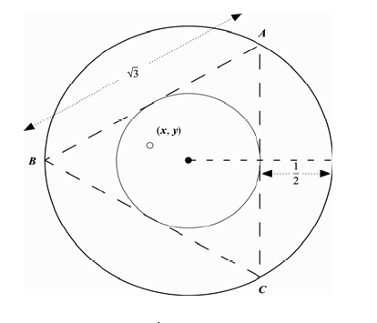
Bertrand 1: The chord’s 2 end points are random on the circumference of the circle.
x₁
x₂
Prob.=
1/3
x₂

Slide 48
Bertrand 2: The Mid-Point of the Chord is Random Inside Circle
Prob. =
1/4

Slide 49

Bertrand 3: The Radial Distance of the Chord Mid-Point is Random in [0, 1]
Prob.
= 1/2

Slide 50
Can you Think of Bertrand 4?
How about a train that moves around the circumference and fails according to a Poisson process. The random chord is between the final train position and the origin of the train trip.

